Slide 1

Pets make your life happier

Slide 2
What pet do you like to keep? Why?
/01

Slide 3
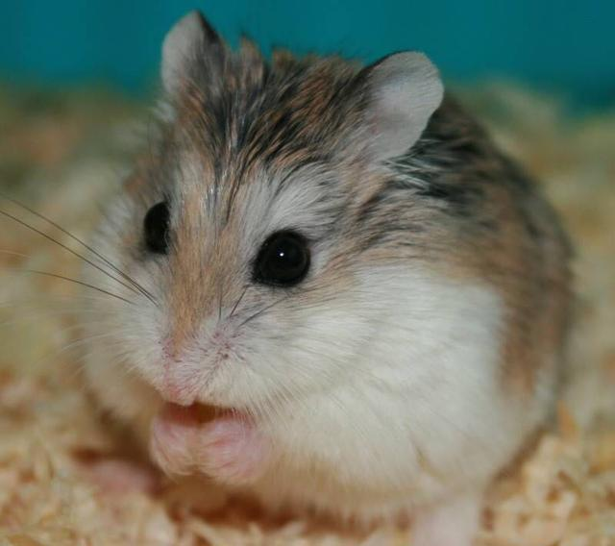
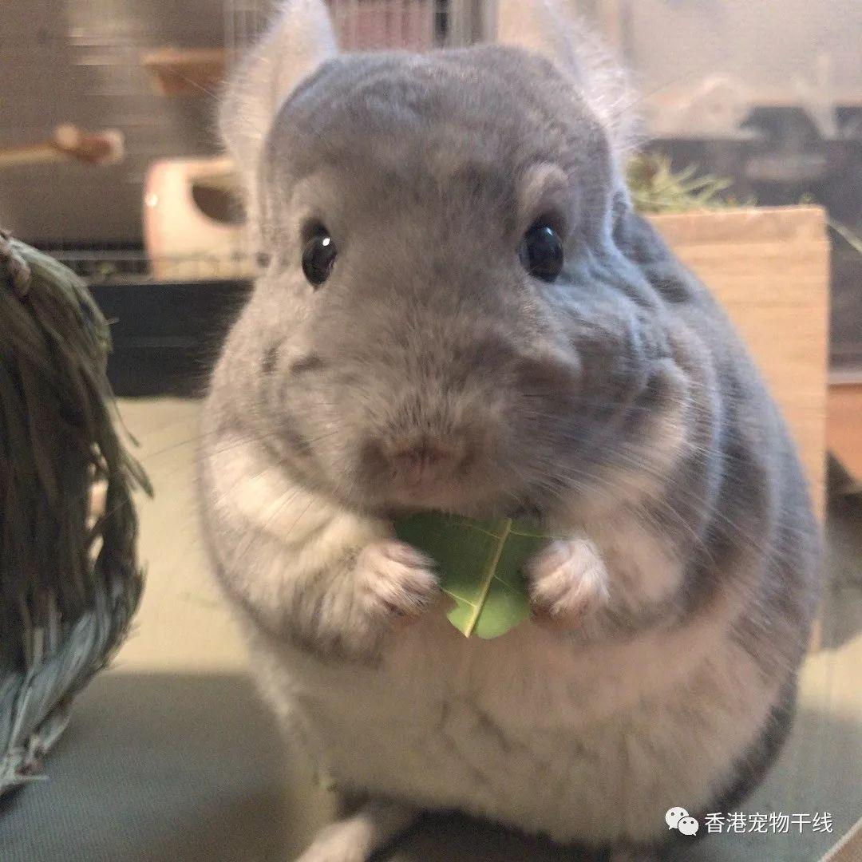
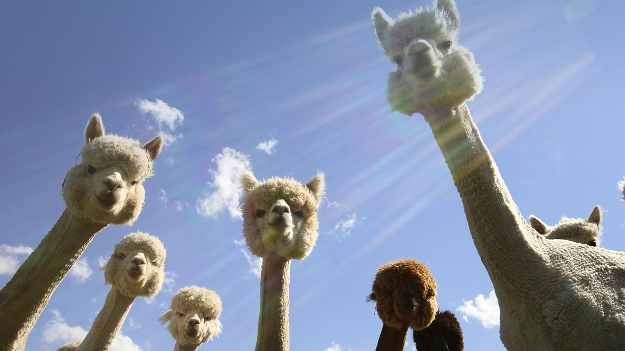
What pet do you like to keep?
Dog
2. Cat
3. Hamster
4. Chinchilla
5. Rabbit
6. Fish
7. Turtle
8. Alpaca
9. Fragrance pig

Slide 4
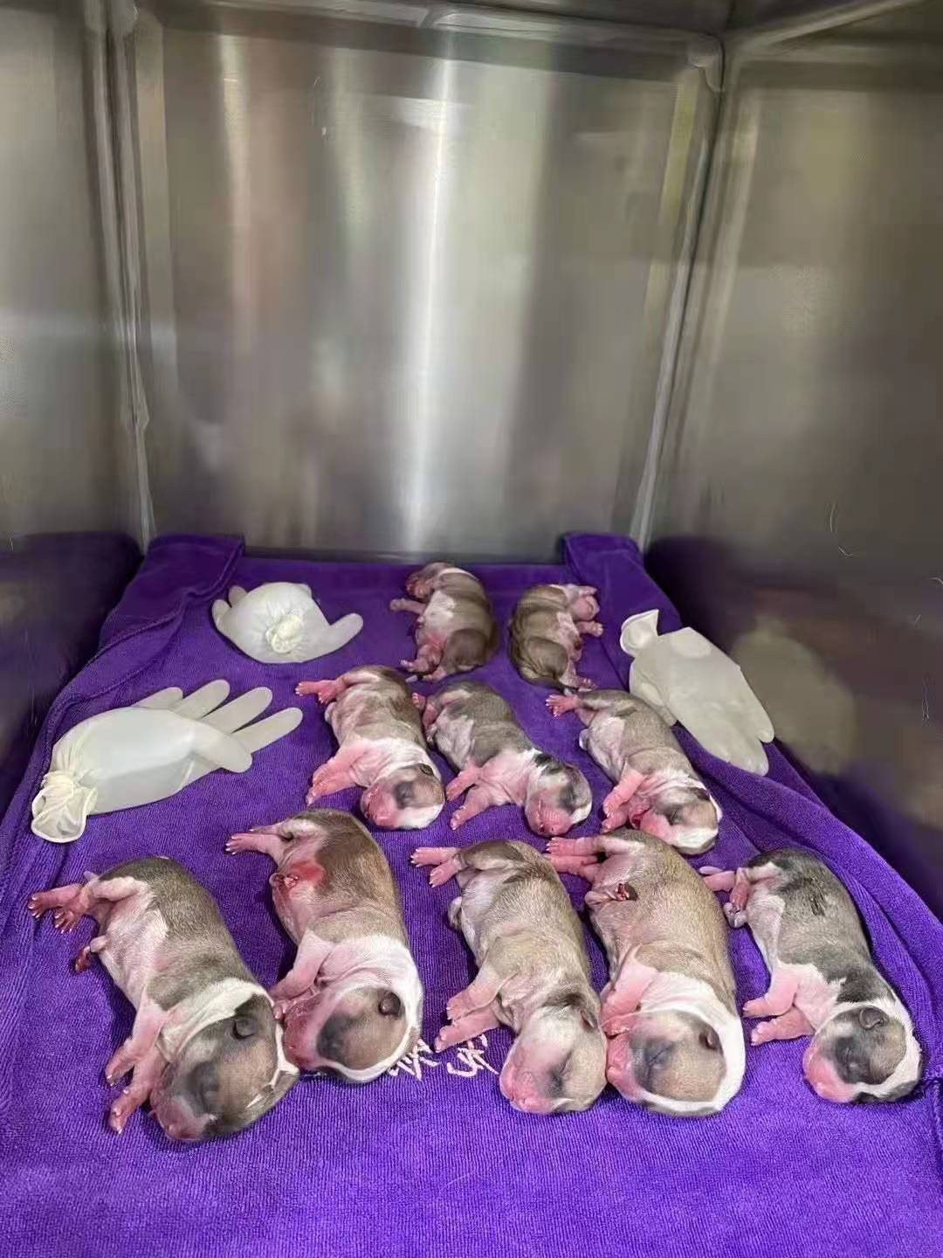
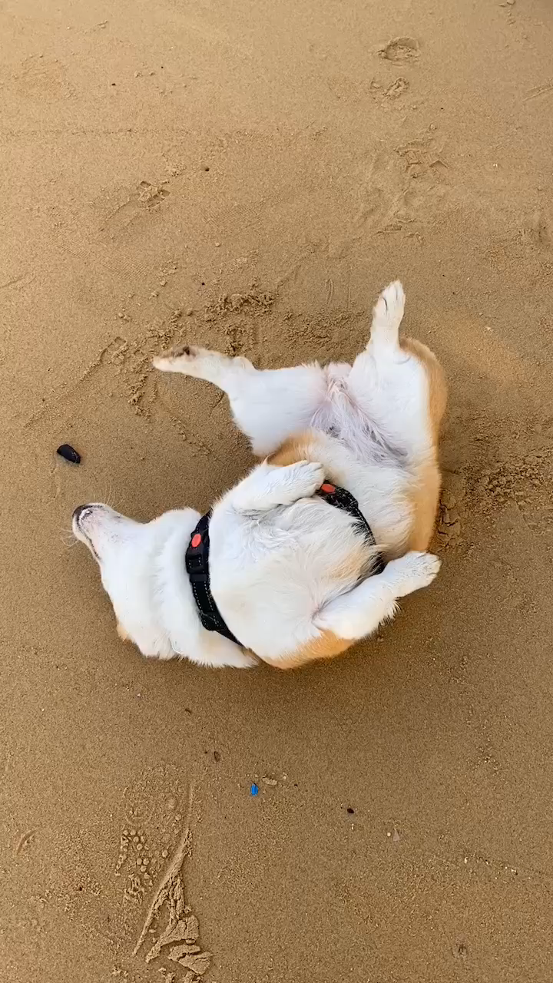
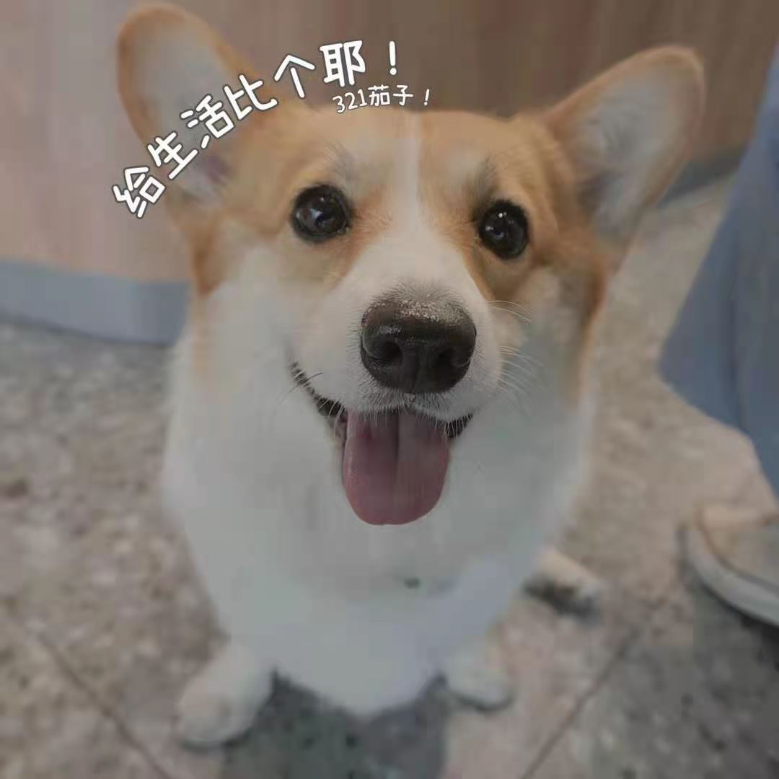
My friend’s pet
Welsh corgi Pembroke(Big ass dog)

Slide 5
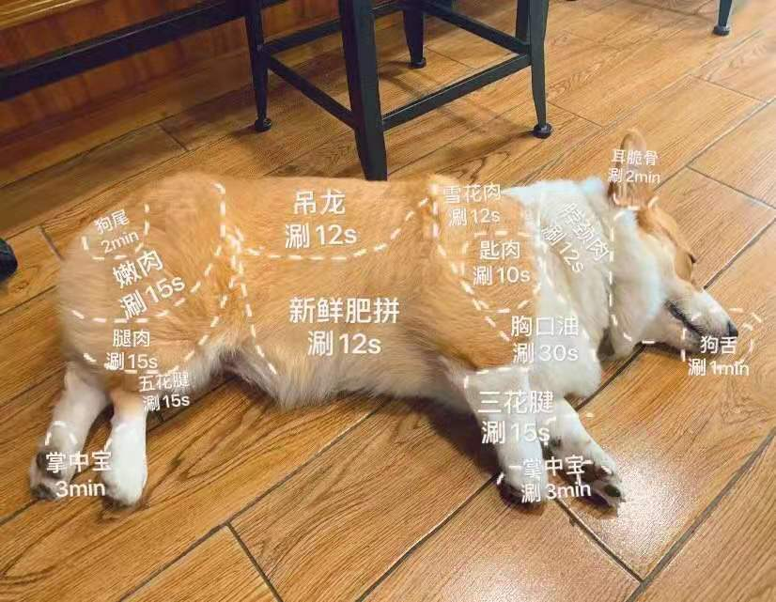
My friend’s pet

Slide 6
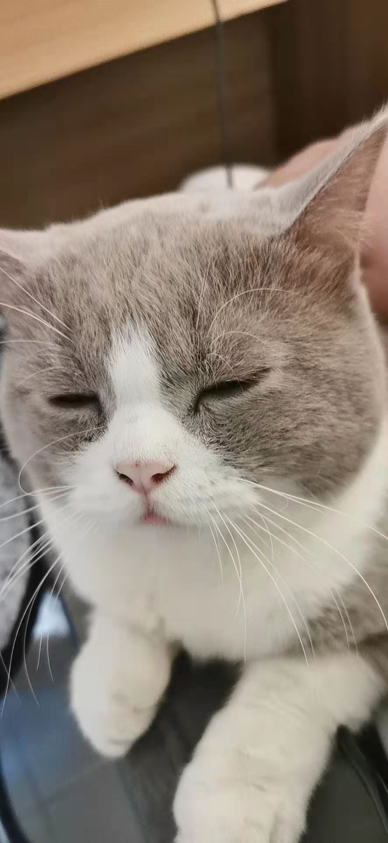
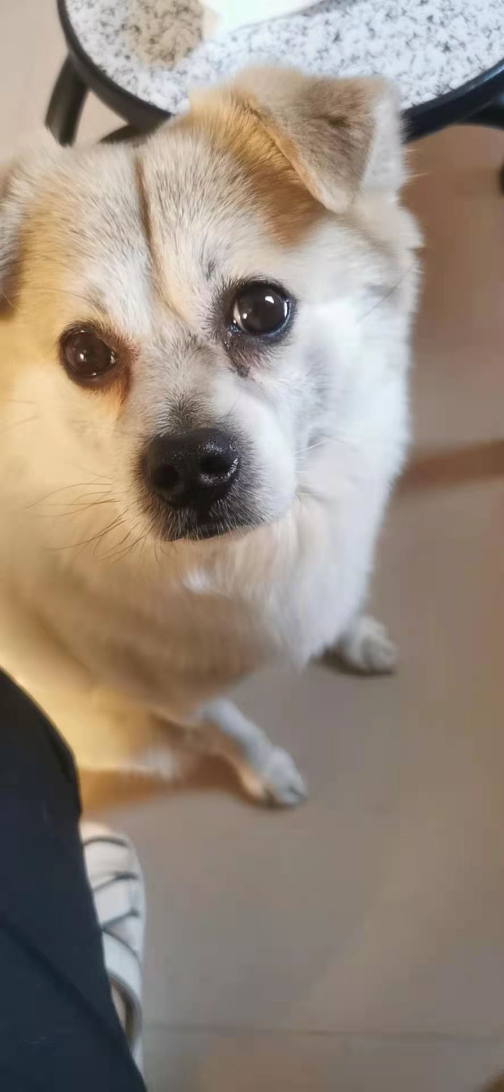
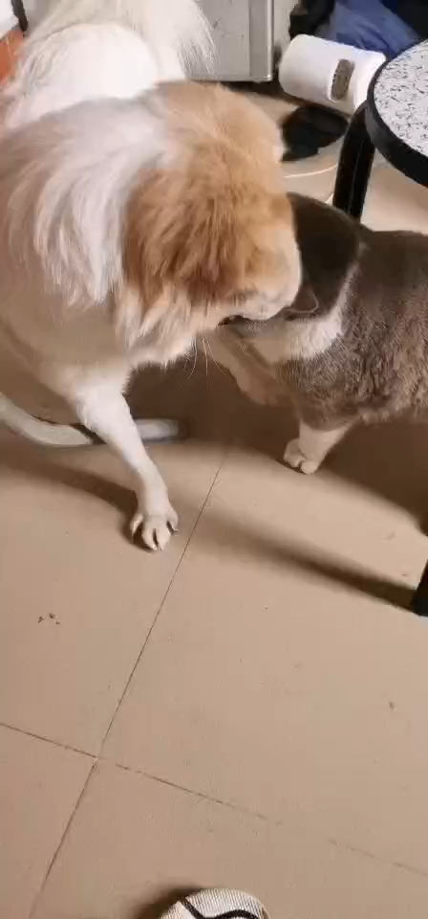
My friend’s pet
British shorthair cat(英短)
Chinese rural dog

Slide 7
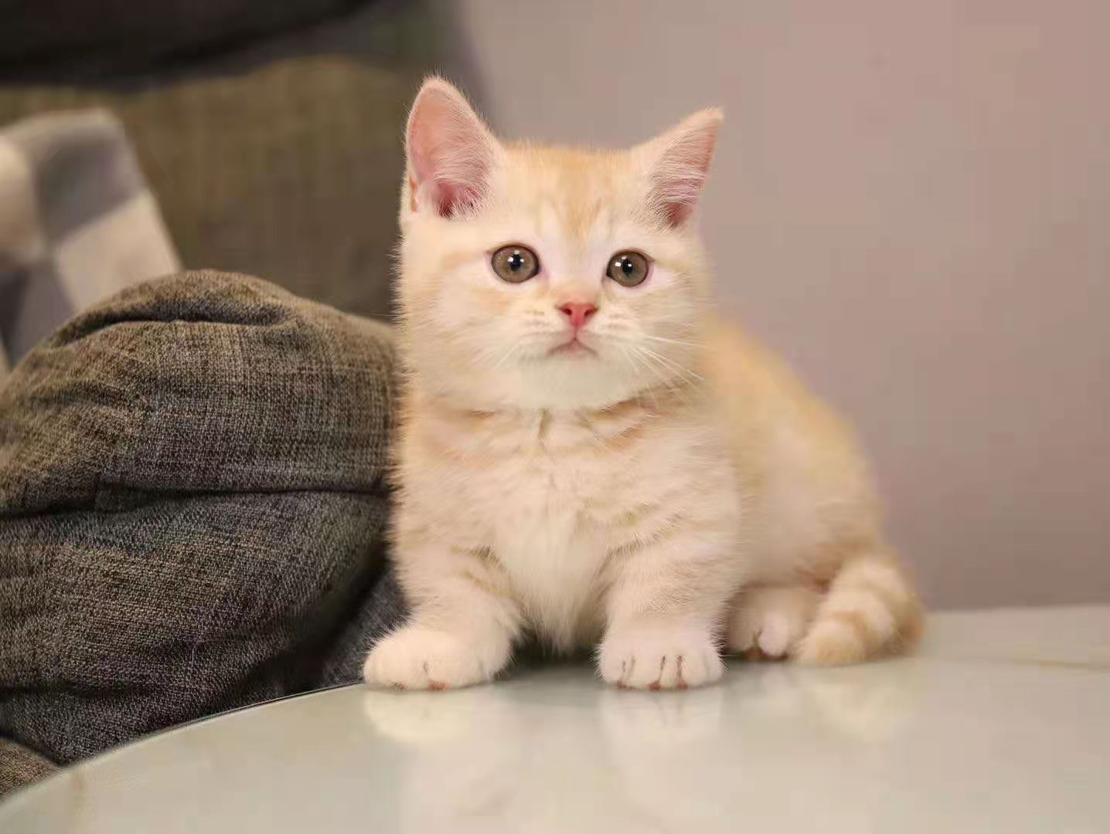
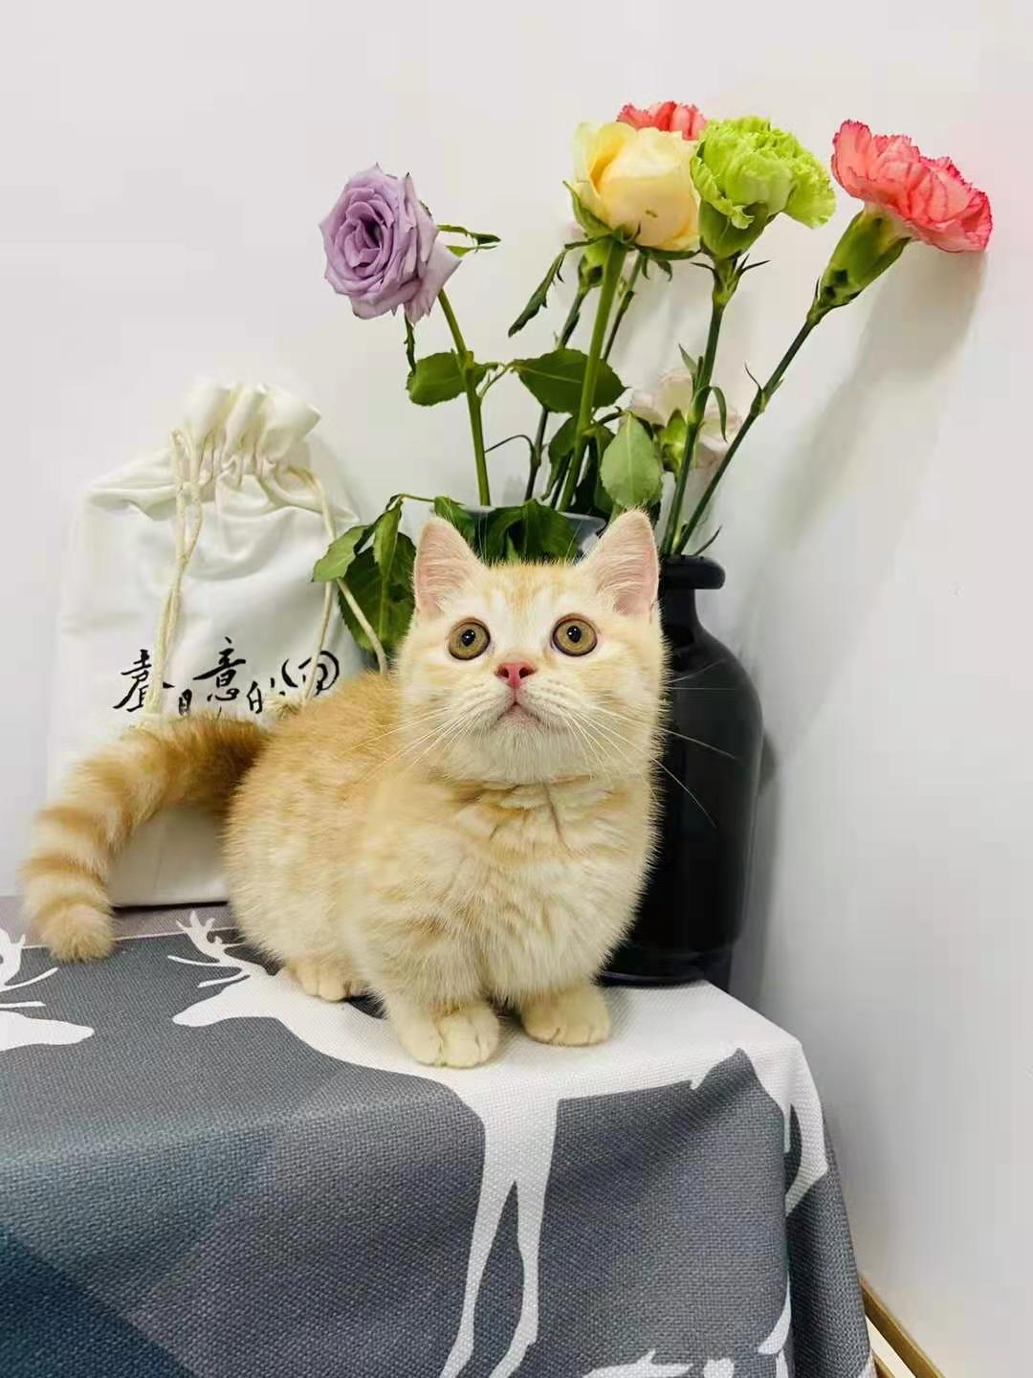
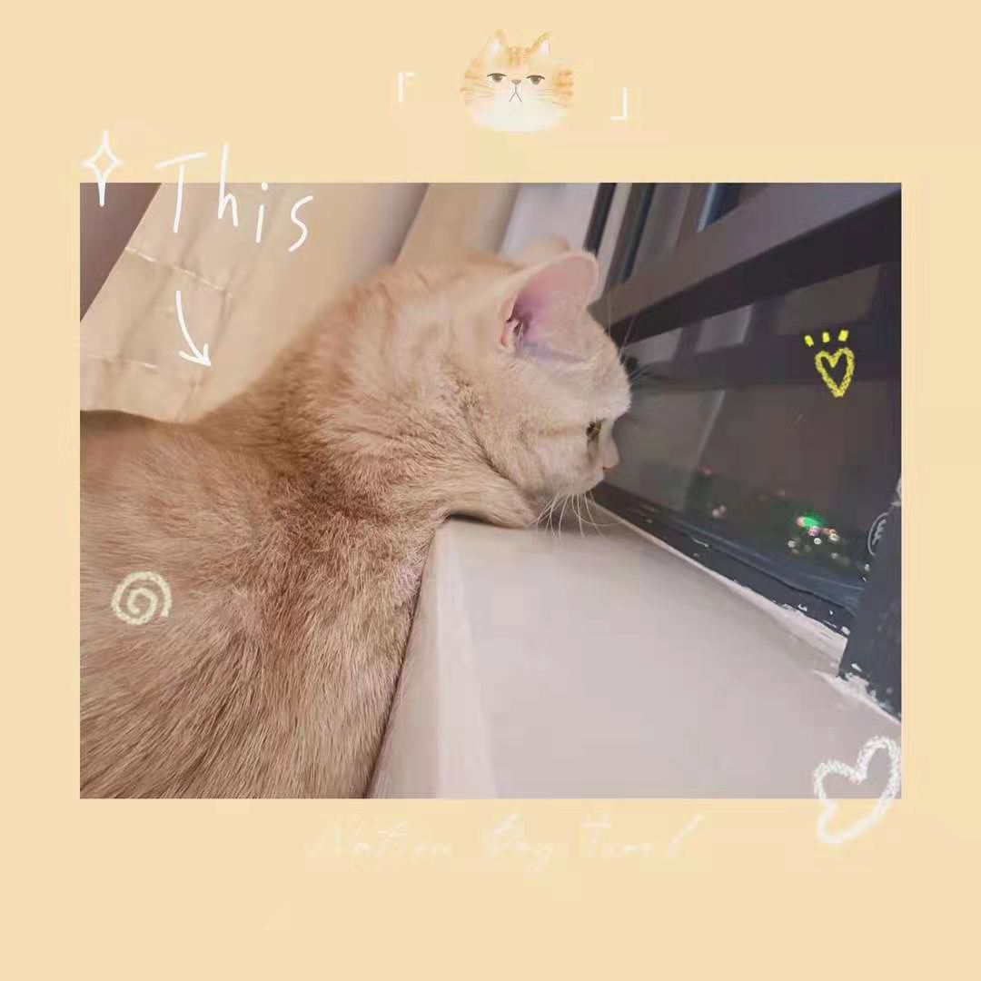
My friend’s pet
Munchkin cats(曼康基矮脚猫)

Slide 8
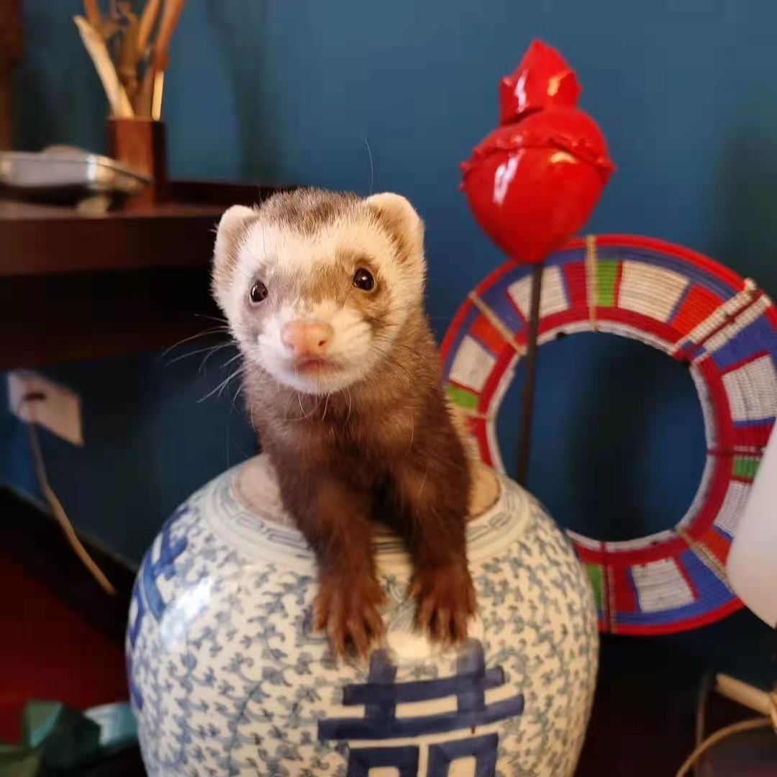
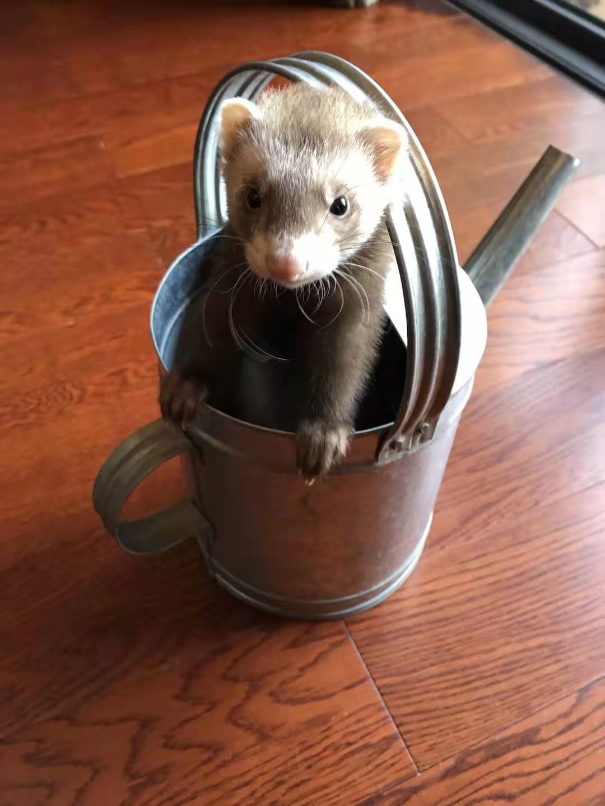
My friend’s pet
Ferret (貂)
Ferret has become the third largest pet among dogs and cats

Slide 9
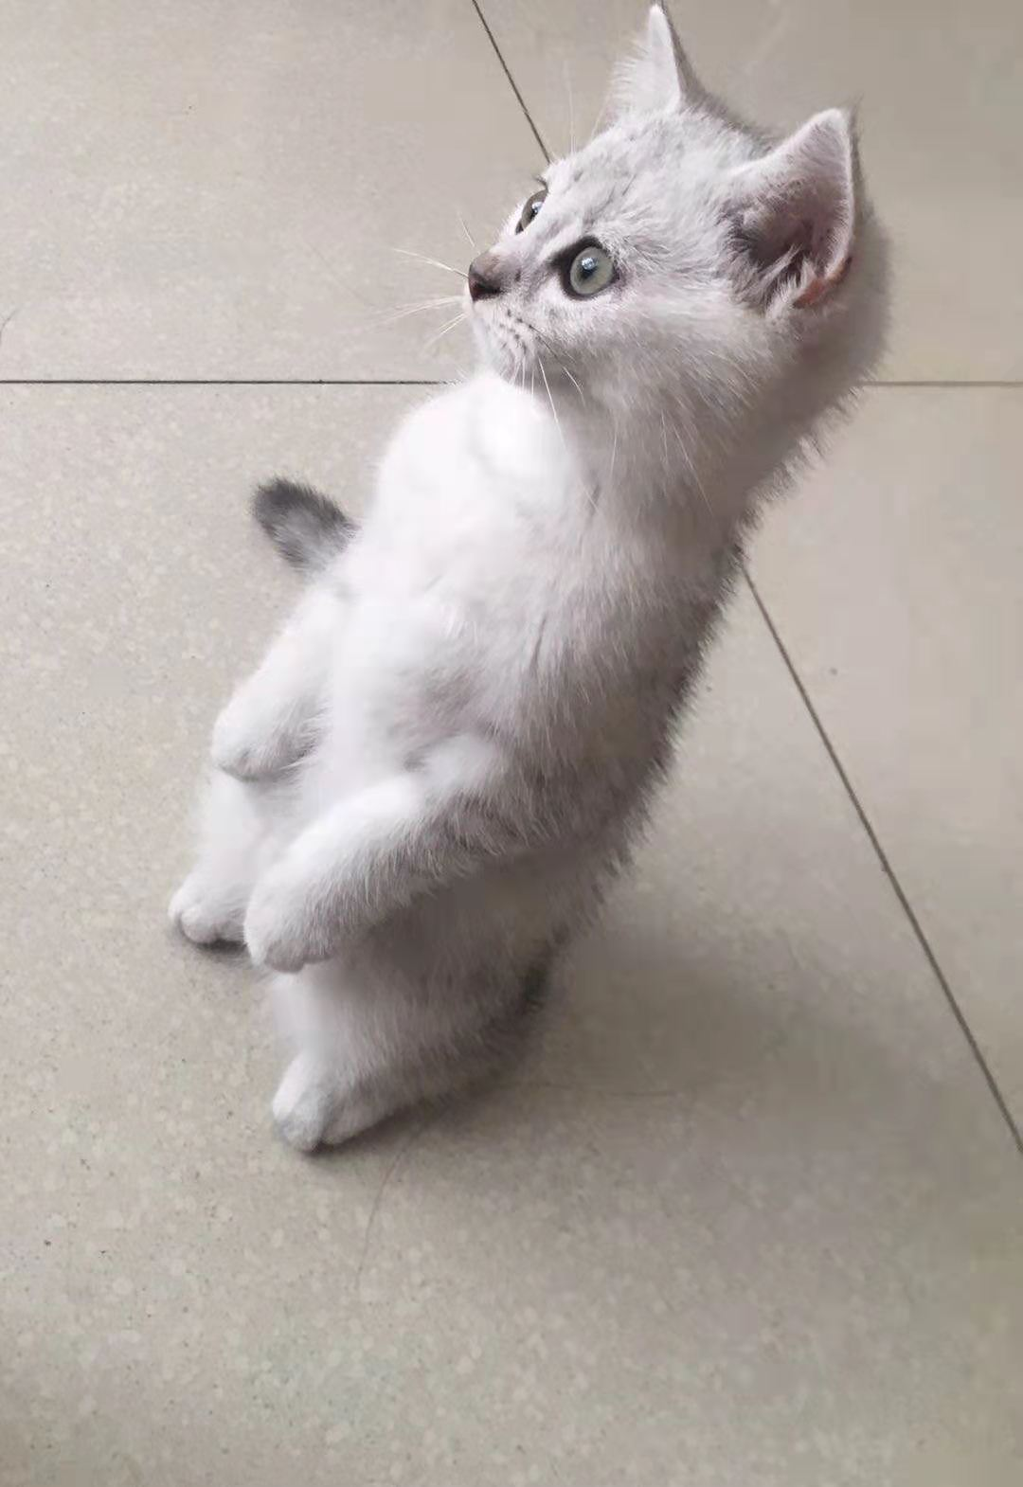
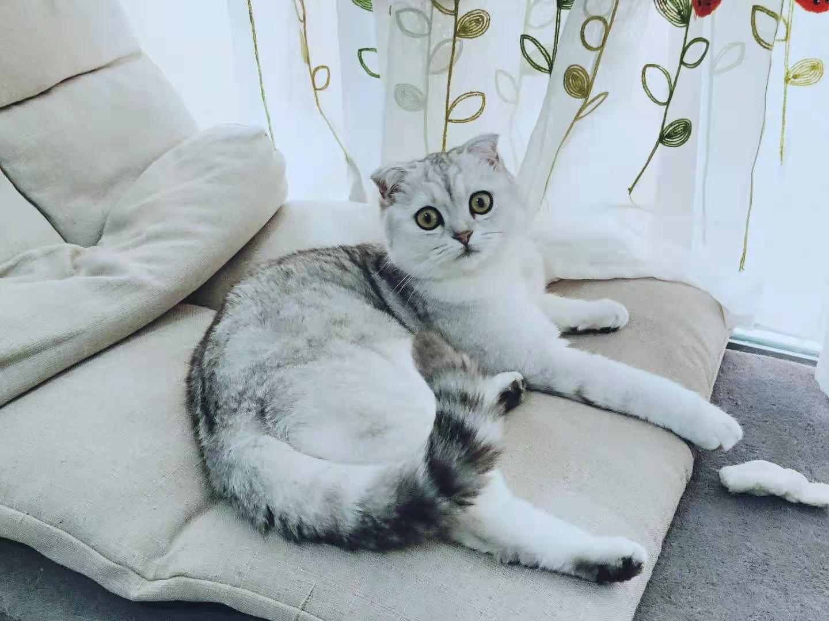
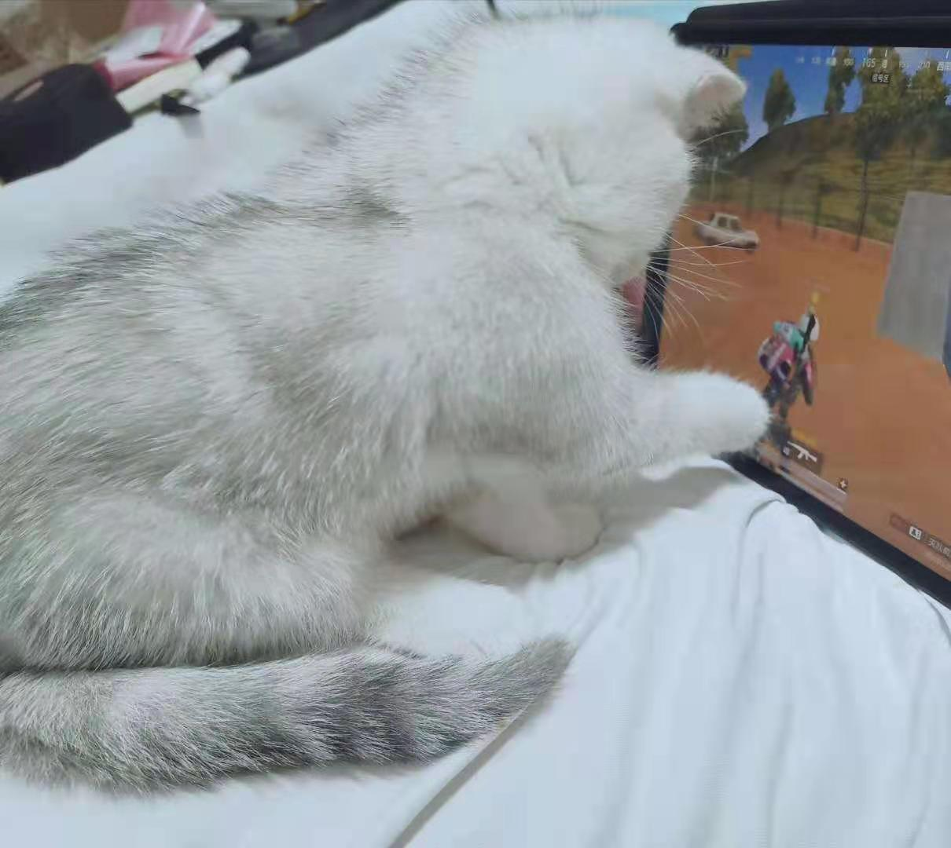
My pet

Slide 10
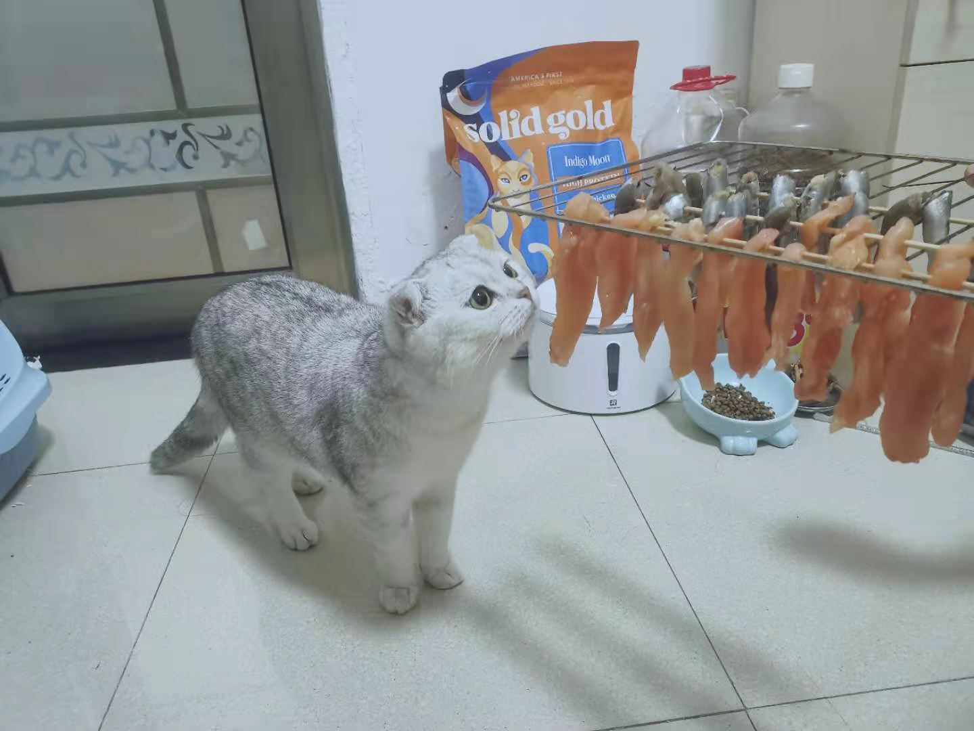
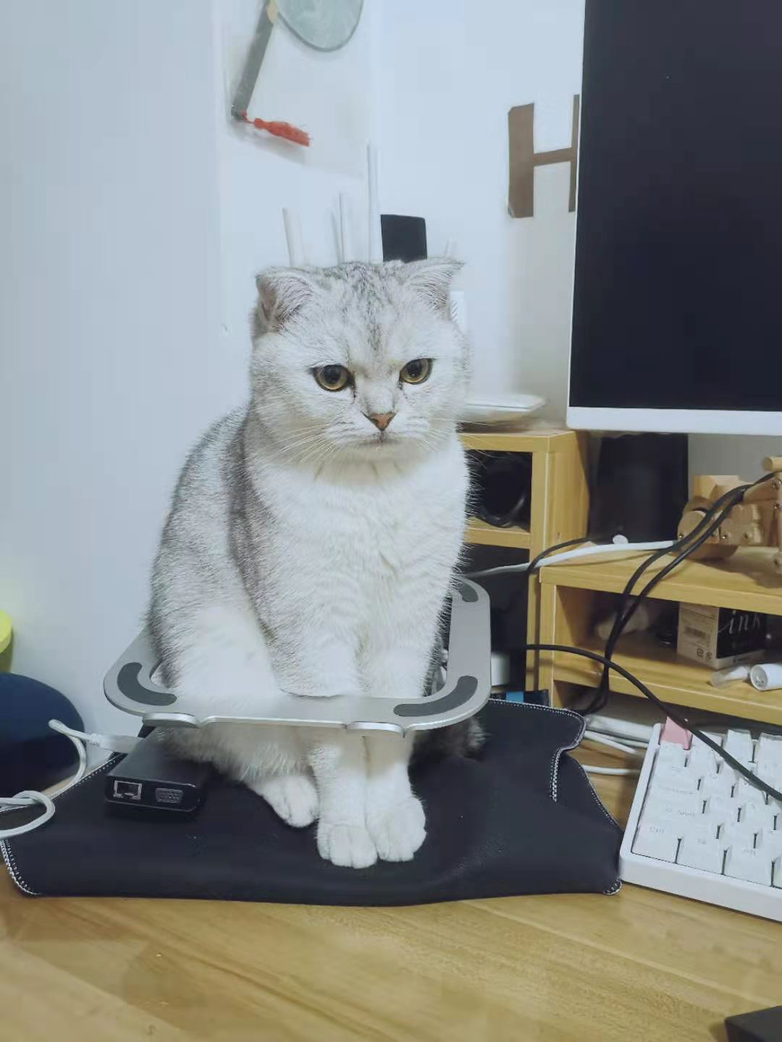
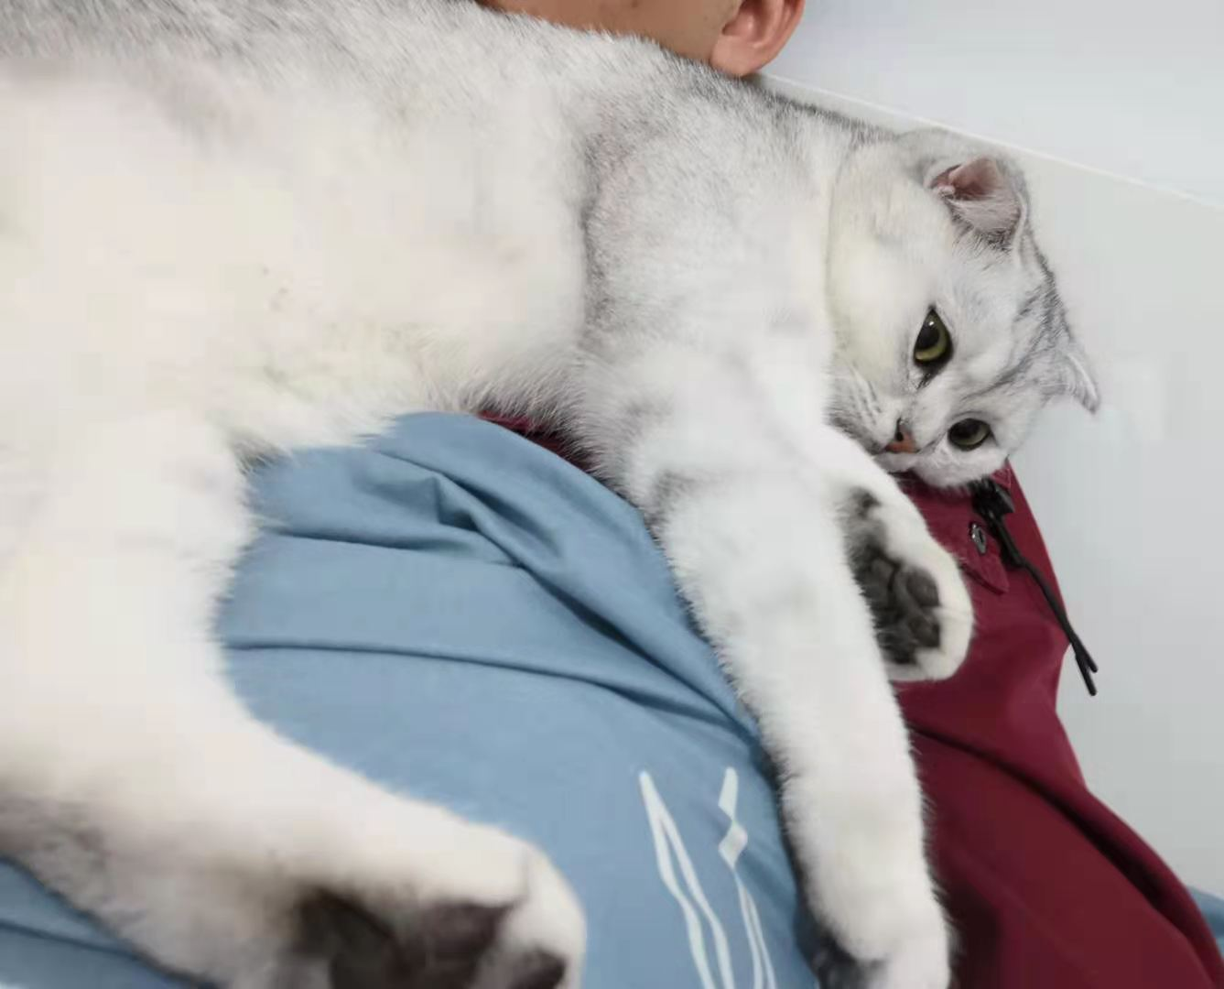
My pet

Slide 11
What pet do you like to keep ?
Question: What is the cat’s name？
Tips:
Feature: too much nonsense
Time: May 2020
Place: Washington
People: A man

Slide 12
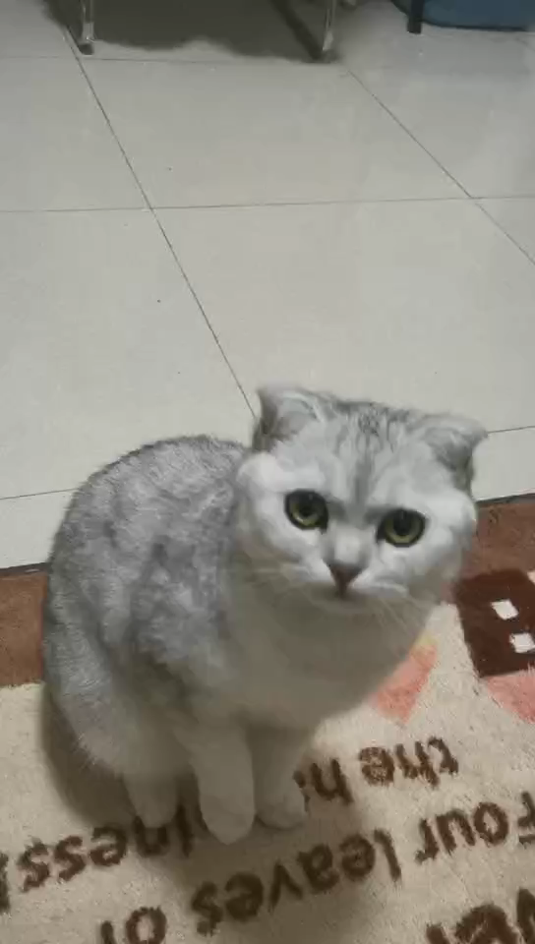
Training skill

Slide 13
Game party
/02

Slide 14
Thanks. And Your Slogan Here.

